Slide 1
CALCULATOR USING PYTHON(Tkinter)
Presented by:
Surabhi Patil

Slide 2
Introduction:
Python is a popular programming language. It is used for web development, software development, system scripting
Python programming language is very well suited for beginners and experienced programmers who are familiar with other programming languages like C++ and Java
The biggest strength of Python is a huge collection of standard libraries that can be used for the following GUI Applications like Kivy, Tkinter, PyQt, etc

Slide 3
Tkinter:
Tkinter is the standard GUI library for Python
Python when combined with Tkinter provides a fast and easy way to create GUI applications
Tkinter provides a powerful object-oriented interface to the Tk GUI toolkit

Slide 4
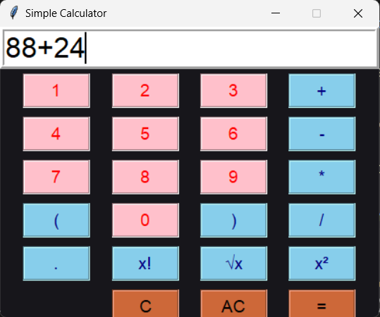
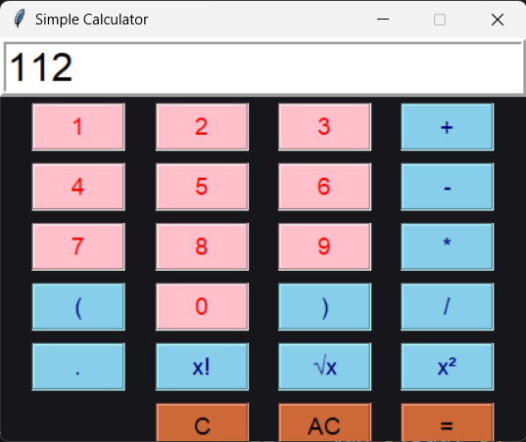
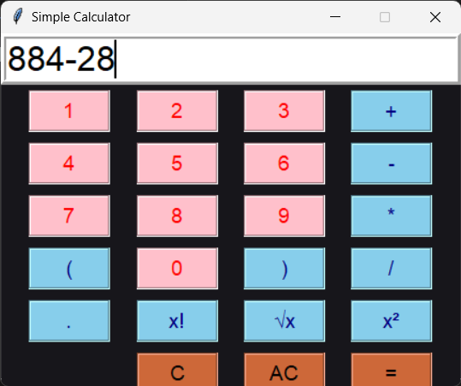
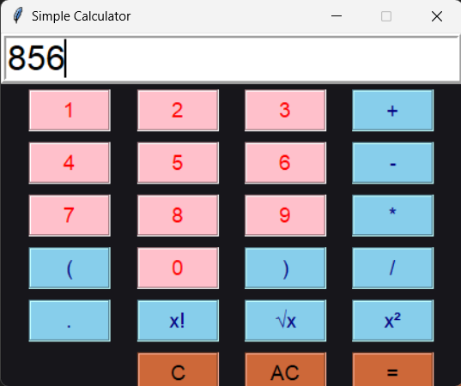
Output:
Addition:
Subtraction:

Slide 5
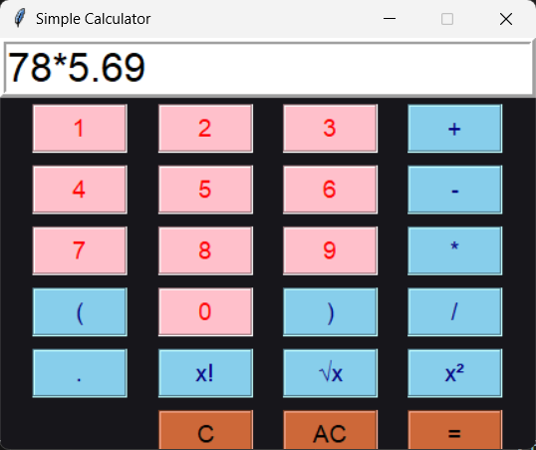
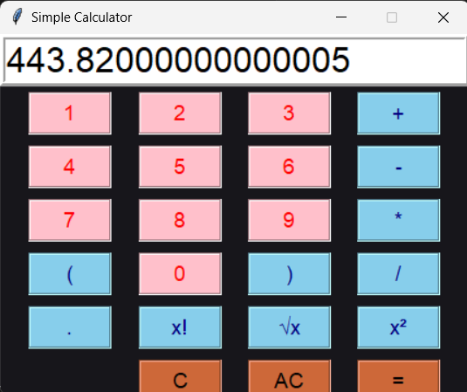
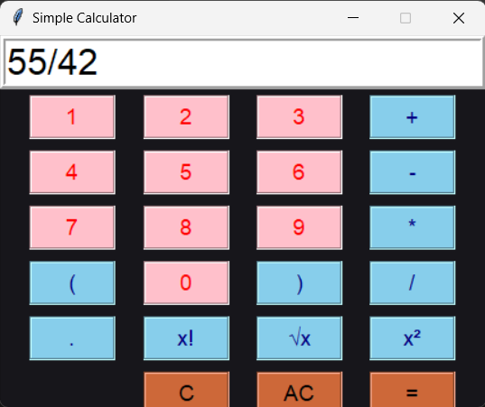
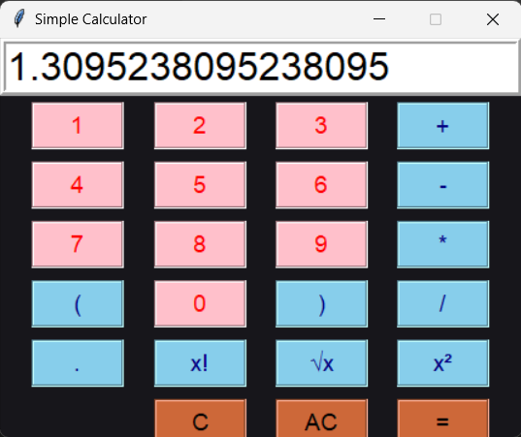
Multiplication:
Division:

Slide 6
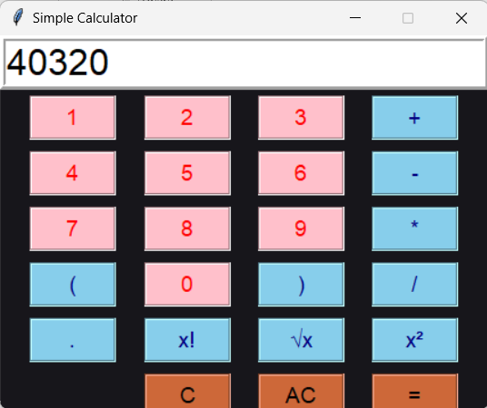


Factorial of 8:
(8!)
The square root of 81:
(√81)
Square of 64:
(64²)

Slide 7
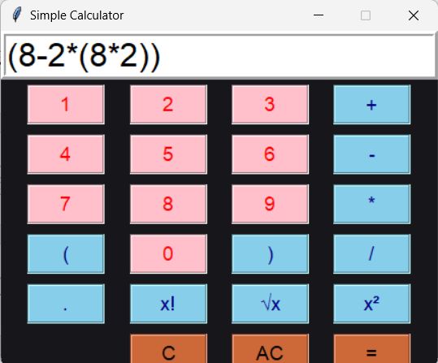
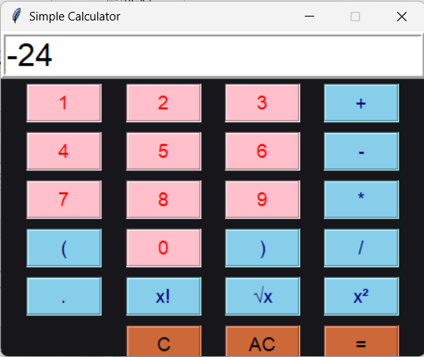
Using multiple brackets:

Slide 8
Conclusion:
Implementation: The code successfully implements a basic calculator using Tkinter, demonstrating a clear understanding of GUI programming and event-driven design
Modular Design: The code is organized into separate functions for adding symbols, evaluating calculations, and clearing the field, showcasing a modular approach to programming
Error Handling: The evaluate_calculation function includes error handling, ensuring a user-friendly experience by displaying an "Error" message when an invalid calculation is attempted.

Slide 9
In conclusion, this project demonstrates a simple yet functional calculator implementation using Tkinter.
Through modular design, error handling, and event-driven programming, we've created a user-friendly calculator that showcases fundamental programming concepts.

Slide 10
THANK YOU

